Slide 1
Balancing the Three R’s: Regulations, Records, and Reports
Dallas, TX ♦ May 18, 2016
Arron Heinerikson

Slide 2
Agenda
The compliance framework
Audits and what you can learn from them
Regulatory Developments
PCMACT - EPA’s Spring 2016 Guidance
RMP/PSM Proposed Changes
TSCA CDR

Slide 3
Compliance Framework
Federal Agency
(U.S. EPA)
Regulations
Congress
Federal Laws
PSD, NSPS,
MACT, Title V
Oversight Authority
State Laws and
Regulations
State Agency
(e.g., SCAQMD/TCEQ)
Regulations
Program
Administration
NSR, PSD, Title V
MACT, NSPS, Local SIPs
Notes:
Once Congress passes a law, the task of putting the law into affect falls into the hands of a regulatory agency.
Laws alone do very little. They set guidelines or goals and give power to a specific federal agency to develop the regulations which implement the laws.
Example:
Congress Passed RCRA
EPA is responsible for determining the exact details of how much hazardous waste can be left in an empty container.
Congress Passed the Endangered Species Act
Department of Interior must decide which species are endangered

Slide 4
Regulations Vs. Permits
Regulations generate requirements that the facility must follow
Emission Standards
Testing, Monitoring, Record Keeping and Reporting
Permits codify all the requirements that apply to equipment and facilities
Pre-Construction Permits (NSR/PTC)
Operating Permits (PTO/Title V)

Slide 5
Compliance Framework
Applicable Requirements
All are fair game during audits
Plans and Procedures
PCMACT – O&M Plans
PCMACT – Site Specific Monitoring Plans
SPCC – Checklists
Etc.

Slide 6
Audits – Learning Opportunity
Site Level
Identify training/education needs
Identify staff support needs
Multi-Site
Identify inconsistencies in interpretations
Opportunities for knowledge sharing

Slide 7
PCMACT – March 2016 Guidance
EPA posted Guidance document 3/16
Shortly after first round of semi-annual reporting submitted by industry
Notable Clarifications
D/F temperature data
Summary Report Due Date – 30 days

Slide 8
PCMACT – A few other items
Do I submit to CEDRI and to the State?
Resetting Operating Parameter Limits
2nd round of annual stack testing will be conducted in latter 2016 to early 2017.
63.1350(b)(1)(iii)(C), suggests that OPLs can be verified, rather than reset
When does OPL take effect?
Stack test date?
Date new OPL calculated?
Other?

Slide 9
RMP and PSM Requirements
Risk Management Program (RMP)
40 CFR 68
Process Safety Management (PSM)
29 CFR 1910.119

Slide 10
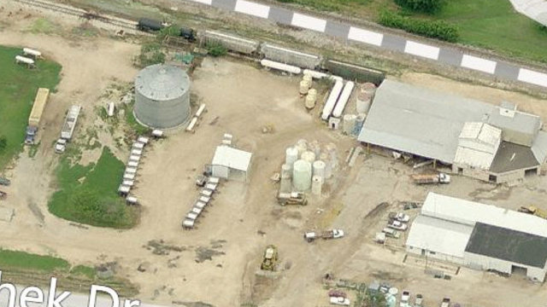
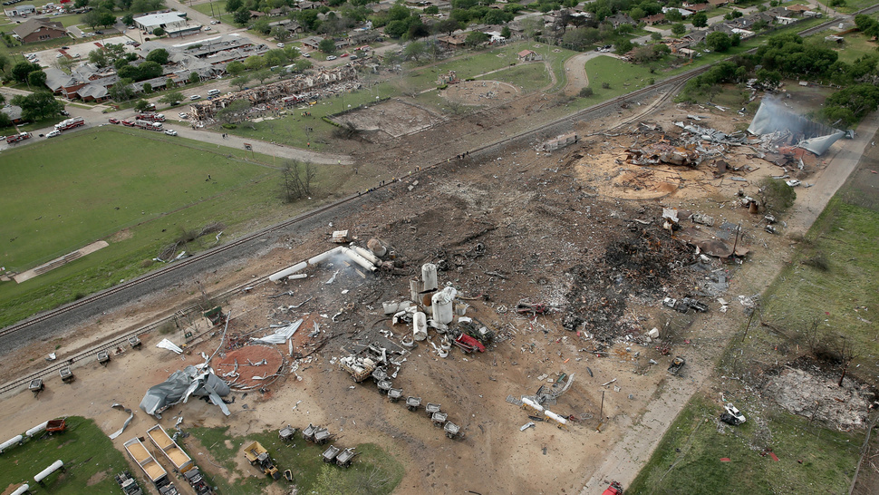
Why the flurry of activity
Executive Order 13650 issued August 1, 2013 in response to recent catastrophes
Requires modernization of many safety standards
December 9, 2013 OSHA issued a Request for Information (RFI) on the PSM program
July 31, 2014 EPA issued a RFI on the RMP program
West Fertilizer Company Before and After April 2013
Notes:
Adding High and/or Low Explosives
In light of the April 17, 2013
explosion in West, Texas involving
ammonium nitrate (AN) fertilizer, EPA
is reconsidering whether it should
include explosives on the RMP list. In
addition to raising concerns about AN,
this accident has shifted attention to
how well facilities handling other
potentially explosive materials are
safeguarding communities from their
hazards and whether emergency
responders are prepared to deal with
accidents involving such materials,
whether or not they are designed to be
used as explosives. This subsection of
the RFI addresses explosives other than
AN—Further discussion of regulating
AN, including AN fertilizer, is covered
later in this section.

Slide 11
RMP Applicability
Applies if site has greater than a threshold quantity of a listed chemical in a process
Historically, portland cement plants have not had these chemicals above threshold quantities
March 14, 2016, EPA proposed RMP rule revisions
Did not include changes to regulated substance list, but EPA indicated they may elect to add ammonium nitrate later.
Industry should continue to monitor RMP rule changes

Slide 12
PSM Applicability
Applies if site has greater than threshold quantity of listed chemical
Historically, portland cement plants have not had these chemicals above these thresholds either
June 5, 2015 “Mixture rule” established for PSM in OHSA guidance– same approach as RMP mixture rule
Previously chemicals only accounted for in their pure form. Now must be accounted if greater than 1% in mixture.
Plants using alternative fuels/Haz Waste should make sure non-applicability documentation reflects new OSHA guidance

Slide 13
PSM Applicability
Anticipate proposed rule changes for PSM in the next few months based on December 2013 OSHA PSM Request for Information
May 5, 2016 OSHA presentation for Small Business Review
Includes list of chemicals to add to Appendix A including Ammonium Nitrate
Background document also attached

Slide 14
Toxic Substances Control Act (TSCA) Chemical Data Reporting (CDR) Rule

Slide 15
CDR Reporting Basics
What is it?
Reporting of chemical substances manufactured or imported for commercial purposes
Need to report is based on production volume during any calendar year since the last principal reporting year

Slide 16
CDR Reporting Basics
When is the report due?
Reporting system will be open June 1-September 30, 2016
Reports will cover 2012, 2013, 2014, and 2015
Subsequent reports continue in the same pattern every 4 years (report in 2020 on 2016, 2017, 2018, and 2019)

Slide 17
CDR Reporting in 2016+
START EARLY, even if you have done it before.
An every 4th-year reporting process means something has likely changed or been forgotten.
User account setup can sometimes have significant lead time.
Preparing the reports often takes longer than expected, with companies scrambling to gather additional information at the last minute.

Slide 18
CDR Reporting in 2016+
What Process Should I Use to Ensure a Successful Report?
Consultants CANNOT totally turn-key these reports. Data gathering takes time from internal staff (see also: start early!)
See EPA fact sheets for additional guidance
June 1, 2016 EPA Webinar
CDR Requirements and use of 2016 eCDRweb reporting tool

