Slide 1
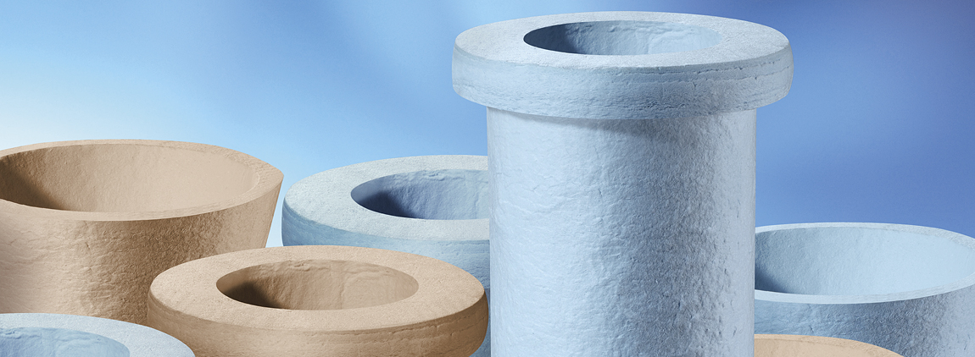
Pyrotex® KE
A single Solution for Hot-Gas Particulate and NO_{x} Control

Slide 2
Temperature 1,560F / 850°C
With or without NO_{x} Catalyst
Calcium-Magnesium-Silicate fibers (CMS)
CMS fibers are bio degradable
Superior chemical resistance
Light-weight construction
High Air permeability of 5 – 35 [l/dm² min] @200 Pa
Conical Collar
T-shaped Collar

Slide 3
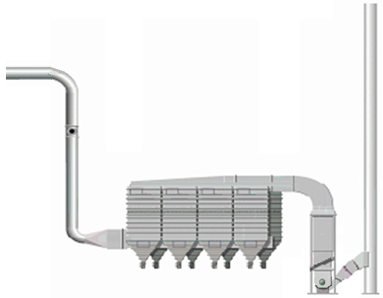
All in One Emission Control
Particulate, SO_{x}, NO_{x},
Injection of:
Particulate Control
PM 2.5, PM 10
SO_{x}: Ca(OH)₂ - (350ºC)
< 1 mg/Nm³
NO_{x}: NH₃ - >95%

Slide 4
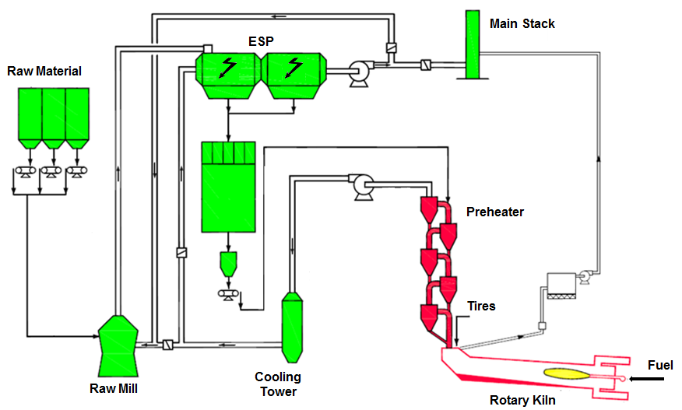
Benefits Cement Plant, 3000 t_{clinker}/day
Conversion to Pyrotex® KE
Potential savings:
1 Mega Joule/10t_{cinker}

Slide 5
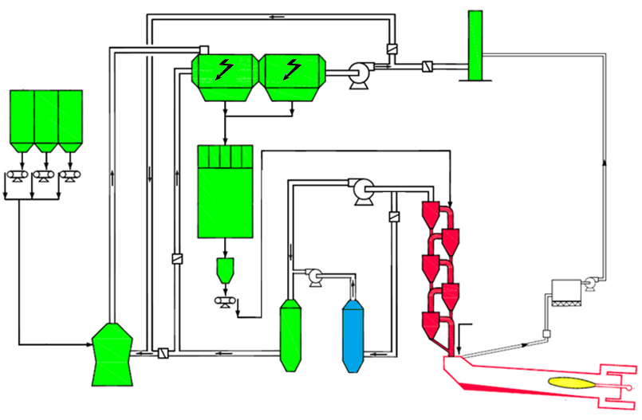
Pilot Filter in a Cement Plant
Main Stack
ESP
Raw Material
Preheater
Bypass Filter
Tires
Fuel
Cooling
Tower
Pilot
Filter
Raw Mill
Rotary Kiln

Slide 6
Catalyst Development
Zeolite and Vanadic Catalysts

Slide 7
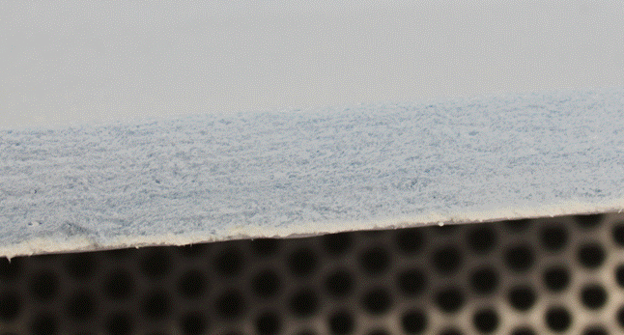
Dust Penetration
0.58 mm
Dust Layer

Slide 8
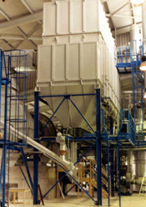
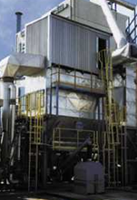
Pyrotex® KE Experience
Glass industry
Incineration - Biomass and Waste
Calcination - Aluminium
Gasification - Wood, Biomass, Residues
Pyrolysis – contaminated soil
Melting process
Carbide oven
Separation of precious metals
Reprocessing of radioactive materials
Cement industry

Slide 9
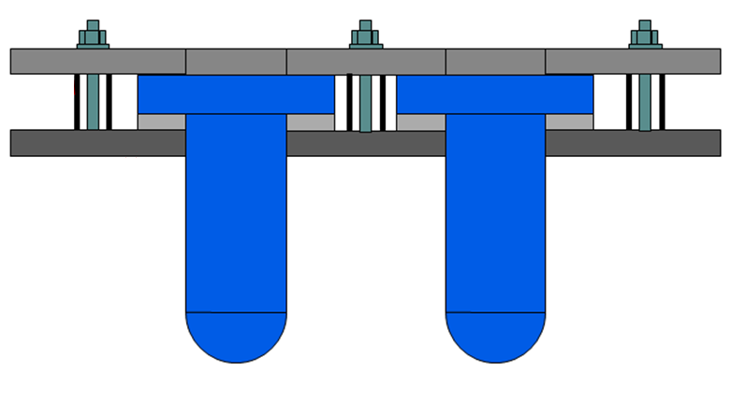
Clamping System
Top Plate
Spacer Ring
Cell Plate
Sealing Felt
Candle Element

Slide 10
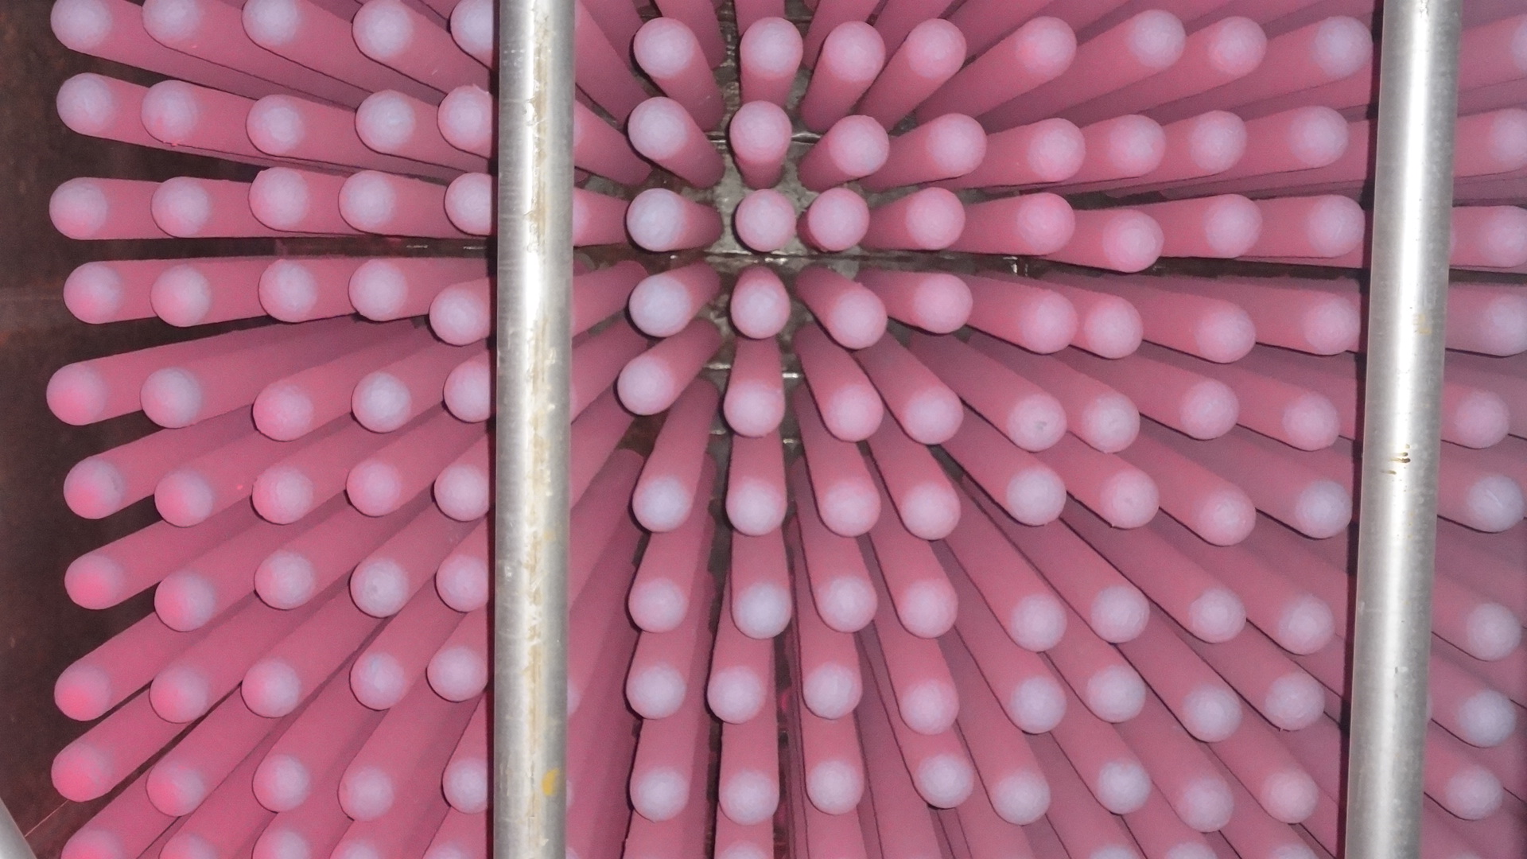
UV Test Results

Slide 11
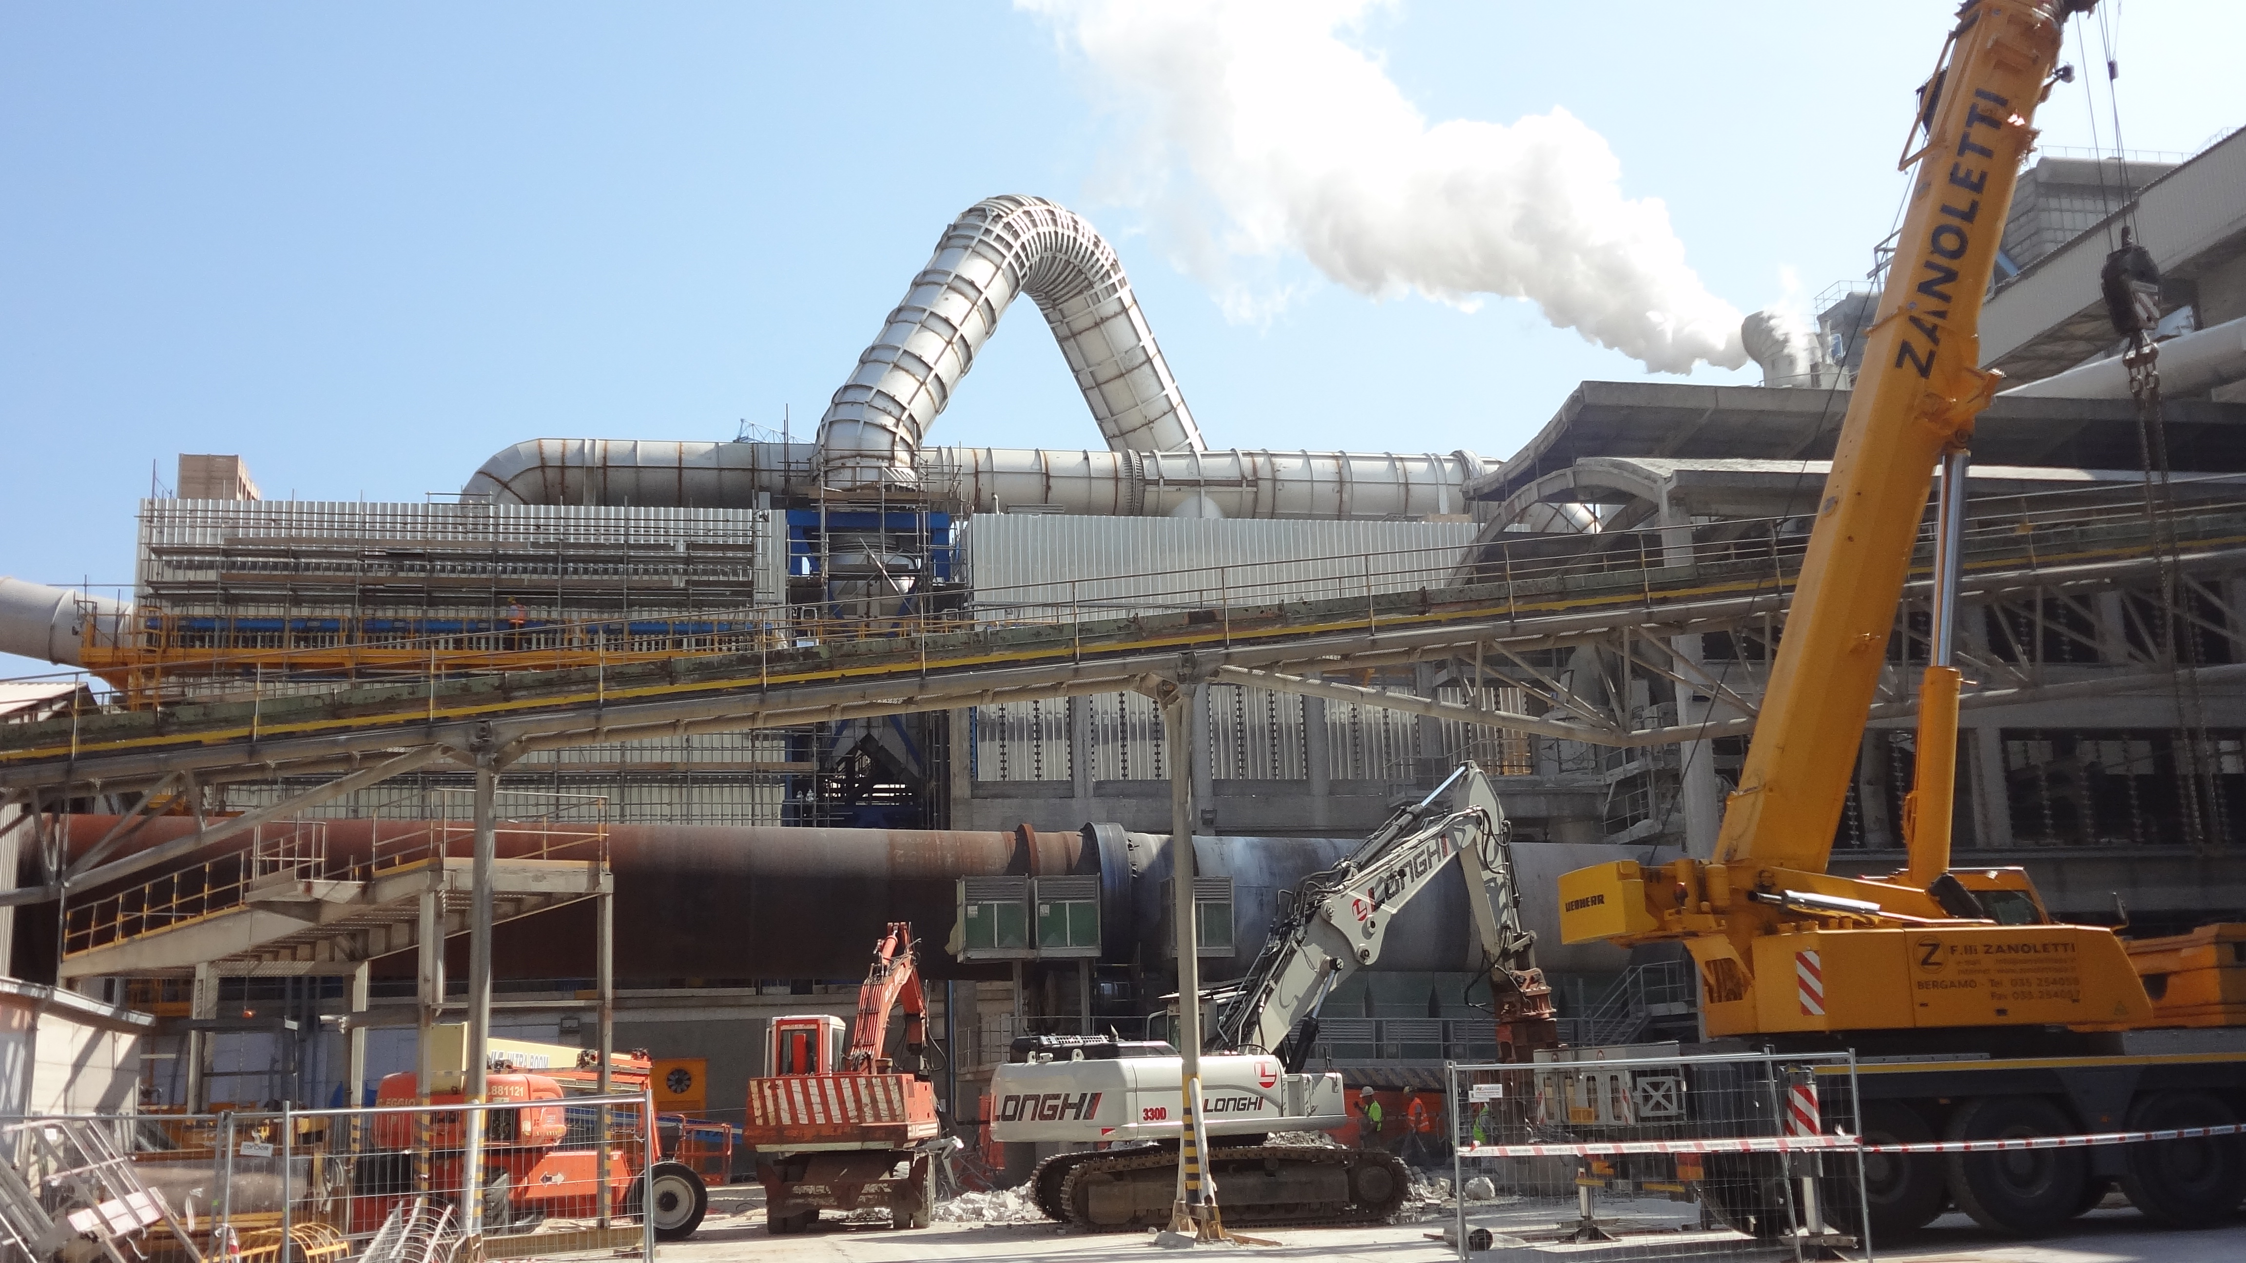
Cement Clinker Cooler
Filter with 2 compartments (1 compartment Pyrotex® KE)
T-shaped elements: 2.400 each
Temperature: t_{operation} = 300°C t_{peak} = 400°C
A/C-Ratio: 0,65 nominal
Particulates: < 10 mg/Nm³
1 full cleaning cycle per day @ 2 bar; Δp = 10 mbar

Slide 12
Pyrotex® KE
Cake Release

Slide 13
Thank you very much

